Slide 1
Best Magazine Spring 2018
Review of PE Separator Content

Slide 2
BEST Article (Spring 2018)
Outline
The BEST Article Premise: Brief Synopsis
Key Separator Design Considerations
  Profile Design: Acid Displacement, Stratification, Paste Retention
  Chemical Additives: Water Loss (Overvoltage), Antimony Transfer
  Porosity: ER, CCA, DCA, RC, Dendritic Shorts, Cycle Life
  Battery Manufacturing Costs: Enveloping, Reduce Mossing
  Mechanical Strength: Low Shrinkage, Optimal Tensile Properties
Round Table Discussion
  Daramic Focused Article Content
  Entek Focused Article Content
  PVC & AGM Focused Article Content

Slide 3
BEST Article (Spring 2018)
The BEST Article Premise: Brief Synopsis
Port Orford Cedar (wood) separators were dominant until about 1945. PVC and Hard Rubber took the place of wood and battery manufacturers were faced with several problems, gassing (H2 overvoltage) was likely the worst. The Cedar acted to increase the H2 overvoltage on the negative. The synthetic separators had no such function. Lignin based expanders entered the scene. This was the first case of the separator acting as more than an permeable insulator recorded.
This article stresses the ever increasing role of the separator to address shortcomings in the design of the battery. The author has spoken to battery & separator manufacturers and he has written a basic summary of his research. This is more of a light review rather than a detailed technical paper.

Slide 4
BEST Article (Spring 2018)
Key Separator Design Considerations
  Profile Design: Acid Displacement, Stratification, Paste Retention
  Chemical Additives: Water Loss (Overvoltage), Antimony Transfer
  Porosity: ER, CCA, DCA, RC, Dendritic Shorts, Cycle Life
  Battery Manufacturing Costs: Enveloping, Reduce Mossing
  Mechanical Strength: Low Shrinkage, Optimal Tensile Properties

Slide 5
BEST Article (Spring 2018)
Key Separator Design Considerations: Profile Design
The design of the profile usually finds influence by one or more of the following four (4) application objectives:
  Acid Displacement Volume
  Active Material Retention Efficiency
  Acid Stratification Mitigation
  Separator Cost via Mass Savings (not mentioned in the article!)
Let’s look at “Acid Displacement” in more detail…
  Unlike electrolytes in other energy storage systems, Lead-Acid “uses” the electrolyte in the reaction and thus L-A batteries are quite sensitive to the quantity of acid (electrolyte) stored within the battery.
  What are the primary properties affected by acid displacement?
    Cold Cranking Amperage (CCA)
    Dynamic Charge Acceptance (DCA)
    Reserve Capacity (RC)
  Important properties! Let’s calculate acid displacement for a profile.

Slide 6
BEST Article (Spring 2018)
Important “tips” to remember when optimizing displacement.
  The Backweb thickness is critical
  The higher the porosity, the more acid residing in the backweb!
  If major ribs can be “discontinuous or segmented” we reduce displacement
  Miniribs on the negative actually increase displacement unless the b/w reduced to compensate.
How do our customers view acid displacement?
Do we need new ideas?

Slide 7
BEST Article (Spring 2018)
Key Separator Design Considerations: Profile Design
The design of the profile usually finds influence by one or more of the following four (4) application objectives:
  Acid Displacement Volume
  Active Material Retention Efficiency
  Acid Stratification Mitigation
  Separator Cost via Mass Savings (not mentioned in the article!)
Retention of active material is important as it affects cycle life
  Design often dictated by the battery mfg. through long internal studies
  Designs vary and must be balanced by displacement and cost
Profile design remains a somewhat unproven “solution” to stratification although new approaches are vigorously underway
Mass reduction via profile design is an important topic but beyond the scope of the article

Slide 8
BEST Article (Spring 2018)
Key Separator Design Considerations
  Profile Design: Acid Displacement, Stratification, Paste Retention
  Chemical Additives: Water Loss (Overvoltage), Antimony Transfer
  Porosity: ER, CCA, DCA, RC, Dendritic Shorts, Cycle Life
  Battery Manufacturing Costs: Enveloping, Reduce Mossing
  Mechanical Strength: Low Shrinkage, Optimal Tensile Properties

Slide 9
BEST Article (Spring 2018)
  Chemical Additives: Water Loss & Antimony Transfer
Demands on battery performance are always increasing!
In the EFB and Motive Power markets, water loss is a critical factor
There is a limit to the additives placed in the “paste”, here the separator can act as a delivery vehicle to the battery.
Water loss occurs in a flooded L-A battery when charging exceeds the overvoltage of Hydrogen. When this occurs, H2 leaves the electrolyte and becomes a gas, it diffuses out of the battery and a reduction in electrolyte volume results…
There are some chemicals that increase the overvoltage of H2, this allows the battery to charge with low loss of electrolyte.

Slide 10
BEST Article (Spring 2018)
  Chemical Additives: Water Loss & Antimony Transfer
Therefore, the separator can act as a vehicle to transport additives into the battery just as the active material can utilize expanders and carbon additives
For many years, Microporous has followed this concept by utilizing various forms of crosslinked natural rubber to suppress the deposition of Antimony (an electrode alloy in specific applications) on the negative plate.
The active chemicals in the rubber are leached into the electrolyte to slow the charge transport of Antimony.
Daramic claims to have similar chemical activity via their natural rubber latex.

Slide 11
BEST Article (Spring 2018)
Key Separator Design Considerations
  Profile Design: Acid Displacement, Stratification, Paste Retention
  Chemical Additives: Water Loss (Overvoltage), Antimony Transfer
  Porosity: ER, CCA, DCA, RC, Dendritic Shorts, Cycle Life
  Battery Manufacturing Costs: Enveloping, Reduce Mossing
  Mechanical Strength: Low Shrinkage, Optimal Tensile Properties

Slide 12
BEST Article (Spring 2018)
  Porosity: ER, CCA, DCA, RC, Dendritic Shorts, Cycle Life
The article emphasizes the role of separator porosity in optimizing several battery performance parameters:
  Battery Internal Resistance → See Below
  Increased Cold Crank Amps (CCA)→Resistance
  Increased Dynamic Charge Acceptance (DCA)→Resistance
  Optimize Reserve Capacity (RC) →Acid Displacement
  Dendrite Protection →Tortuosity Factor
  Cycle Life (Round Trip Efficiency) →Resistance

Slide 13
BEST Article (Spring 2018)
  Porosity: ER, CCA, DCA, RC, Dendritic Shorts, Cycle Life
  Separator Porosity Content is a Compromise
    Too Much Porosity May Lead to Poor Oxidation Resistance, Poor Puncture Resistance, Dendrite Issues & Weakened Tensile Properties
    Too Little Porosity (or Excessive Tortuosity) May Present Multiple Issues in Battery Service, and a Potential for Longer Formation Times
  Pore Size Distribution is a Function of the Production Process
    Below, the pore distribution for a UHMWPE membrane at 1.8:1 Si:PE

Slide 14
BEST Article (Spring 2018)
Key Separator Design Considerations
  Profile Design: Acid Displacement, Stratification, Paste Retention
  Chemical Additives: Water Loss (Overvoltage), Antimony Transfer
  Porosity: ER, CCA, DCA, RC, Dendritic Shorts, Cycle Life
  Battery Manufacturing Costs: Enveloping, Reduce Mossing
  Mechanical Strength: Low Shrinkage, Optimal Tensile Properties

Slide 15
The 4th Active Material
  Battery Manufacturing / Mechanical Strength
  Battery & Separator Manufacturing Innovation
    Enveloping equipment has become faster, more efficient.
    Various improvements have been made in electrode fabrication
    Separator manufacturers have kept pace; working with manufacturers to optimize stiffness & profile design as well as puncture and tensile properties
    Separator manufacturers have also concentrated on novel concepts to produce a lower cost product offering performance in the range of more sophisticated higher price offerings.
    Separator raw material suppliers have been involved in innovation as well. Silica suppliers offering engineered grades targeting low ER separators, polymer suppliers concentrating on higher molecular weights for enhanced oxidation resistance.

Slide 16
Separators
The 4th Active Material

Slide 17
The 4th Active Material
Battery Separators
“The 4th Active Material”
And how they impact:
  Battery Performance
  Battery Life
  Manufacturability / Assembly

Slide 18
The 4th Active Material
  Battery Performance
    Automotive
      Cranking power (Electrical Resistance)
      Reserve Capacity (Acid Displacement)
    Deep Cycle
      Ah Capacity (Rib design – Height & Pitch)
      Paste Adhesion (Rib Pitch & Glass Matte)

Slide 19
The 4th Active Material
  Battery Life
    Short Protection
      Puncture resistance / Abrasion resistance
        Grid wires and paste lumps
      Hydration Short protection
        Deep Discharge – Ford “Light Bulb” Test
    Gassing / Water Loss
      Hydrogen overvoltage
        Automotive – Water Loss (VW Water Loss Test Spec 3g/Ah)
        Deep Cycle – Charge Efficiency, Capacity Loss, Water Loss
    Glass Matte
      Glass mattes are used to improve battery life in deep cycle applications. The matte holds the PEM to the grid thus reducing shedding and the associated capacity loss and mossing shorts.
    Rib Pitch / Shape
      The proper rib design can extend battery life through
    Oxidation Resistance
      A separator with poor oxidation resistance can reduce battery life when the separator becomes brittle.
    Dendrite Inhibition
      A separator that is easily penetrated will reduce battery life.

Slide 20
The 4th Active Material
  Manufacturability / Assembly
    Envelopes
      Typically PE or CF
      Separators purchased by the roll
      Automation - Speed and continuous processing on the plate
      Land area used for crimping
      More robust
      Less battery scrap due to shorts
    Sleeves
      Typically PE or CF
      Separators purchased by the roll
      Automation – Sleeves made and stored
      Ultrasonic sealing on sleeves
      More robust
    Leaf Separators -
      Typically FS, AS and other non-PE materials
      Separators purchased as cut pieces by the box
      Hand stacking or Shuttle Stackers
      Better for acid distribution in the cell
      Cells must have “mud” rests

Slide 21
The 4th Active Material
Antimony Poisoning
&
“The Rubber Effect”

Slide 22
The 4th Active Material
A Vicious Cycle
WATER LOSS
Positive Grid Corrosion
Antimony Poisoning
Increased Charging Required
Antimony Release from Positive Grid
Reduces Charge Efficiency of Negative Plate
Antimony Deposits on Negative Electrode
Reduces Hydrogen Over-Potential Increased Gassing
Notes:
A side effect of the changes in negative plate potential, reduction in charge efficiency and increased charging requirements is water loss. Water is hydrolyzed preferentially at the antimonial sites on the negative plate, as part of the overcharge reactions that I referred to earlier. In addition, the greater energy required for recharge will lead to increased water consumption on the positive plate.
In a constant-voltage recharge, increasing current at the end of charge may easily be tracked. In the same way, in a constant-current recharge, the voltage at the end of the charge step will gradually fall. Both of these phenomena may be tracked and are understood to be proportional to the amount of antimony which has deposited on the negative plates in a battery.

Slide 23
The 4th Active Material
Positive Grid Corrosion
WATER LOSS
Rubber is a Solution
Increased Charging Required
Antimony Release from Positive Grid
RUBBER EFFECT
Reduces Charge Efficiency of Negative Plate
Antimony Deposits on Negative Electrode
Reduces Hydrogen Over-Potential Increased Gassing
Notes:
This effect has been documented and understood in the industry, for some time. It is established that the rubber effect is able to stop the vicious cycle, keeping the antimony that has deposited on the negative electrode from altering the charging behavior of the plate. In this way, the effects of water loss and increased grid corrosion are reduced significantly, and the end of charge behavior of the battery remains consistent through the life of the battery.

Slide 24
The 4th Active Material
Rubber is a Solution
Positive Grid Corrosion
INCREASED CYCLE LIFE
Antimony Release from Positive Grid
RUBBER EFFECT
DECREASED WATER LOSS
(Less Watering)
Antimony Deposits on Negative Electrode
Notes:
And so, the ultimate impact of the rubber effect is increased cycle life of the battery. This effect is found to varying degrees with all of the rubber-based separators that we, Microporous, manufactures, including Ace-Sil, but it is also well documented that FlexSil has the greatest ‘rubber effect’, and hence is the separator of choice for all original equipment golf car manufacturers.

Slide 25
The 4th Active Material
Antimony Suppression
Golf Car -
BATTERY TEST COMPARISON -
Natural Rubber
Separators
Enhance
Capacity
Retention
Notes:
Here is some customer data comparing side by side cycle life tests.

Slide 26
The 4th Active Material
Antimony Suppression
Golf Car -
BATTERY TEST COMPARISON -
Natural Rubber
Produces
Lower End
Of Change
Currents
- Less Gassing!
Notes:
Now taking a closer look at the same tests we compare end of charge current. Note how Flex-Sil suppresses the gassing and associated high end of charge current.

Slide 27
The 4th Active Material
Antimony Suppression
Golf Car -
BATTERY TEST COMPARISON -
Natural Rubber
Separators
Reduce Water
Loss
Notes:
Finally, water addition was tracked and again antimony suppressing capability of FlexSil is astonishing.

Slide 28
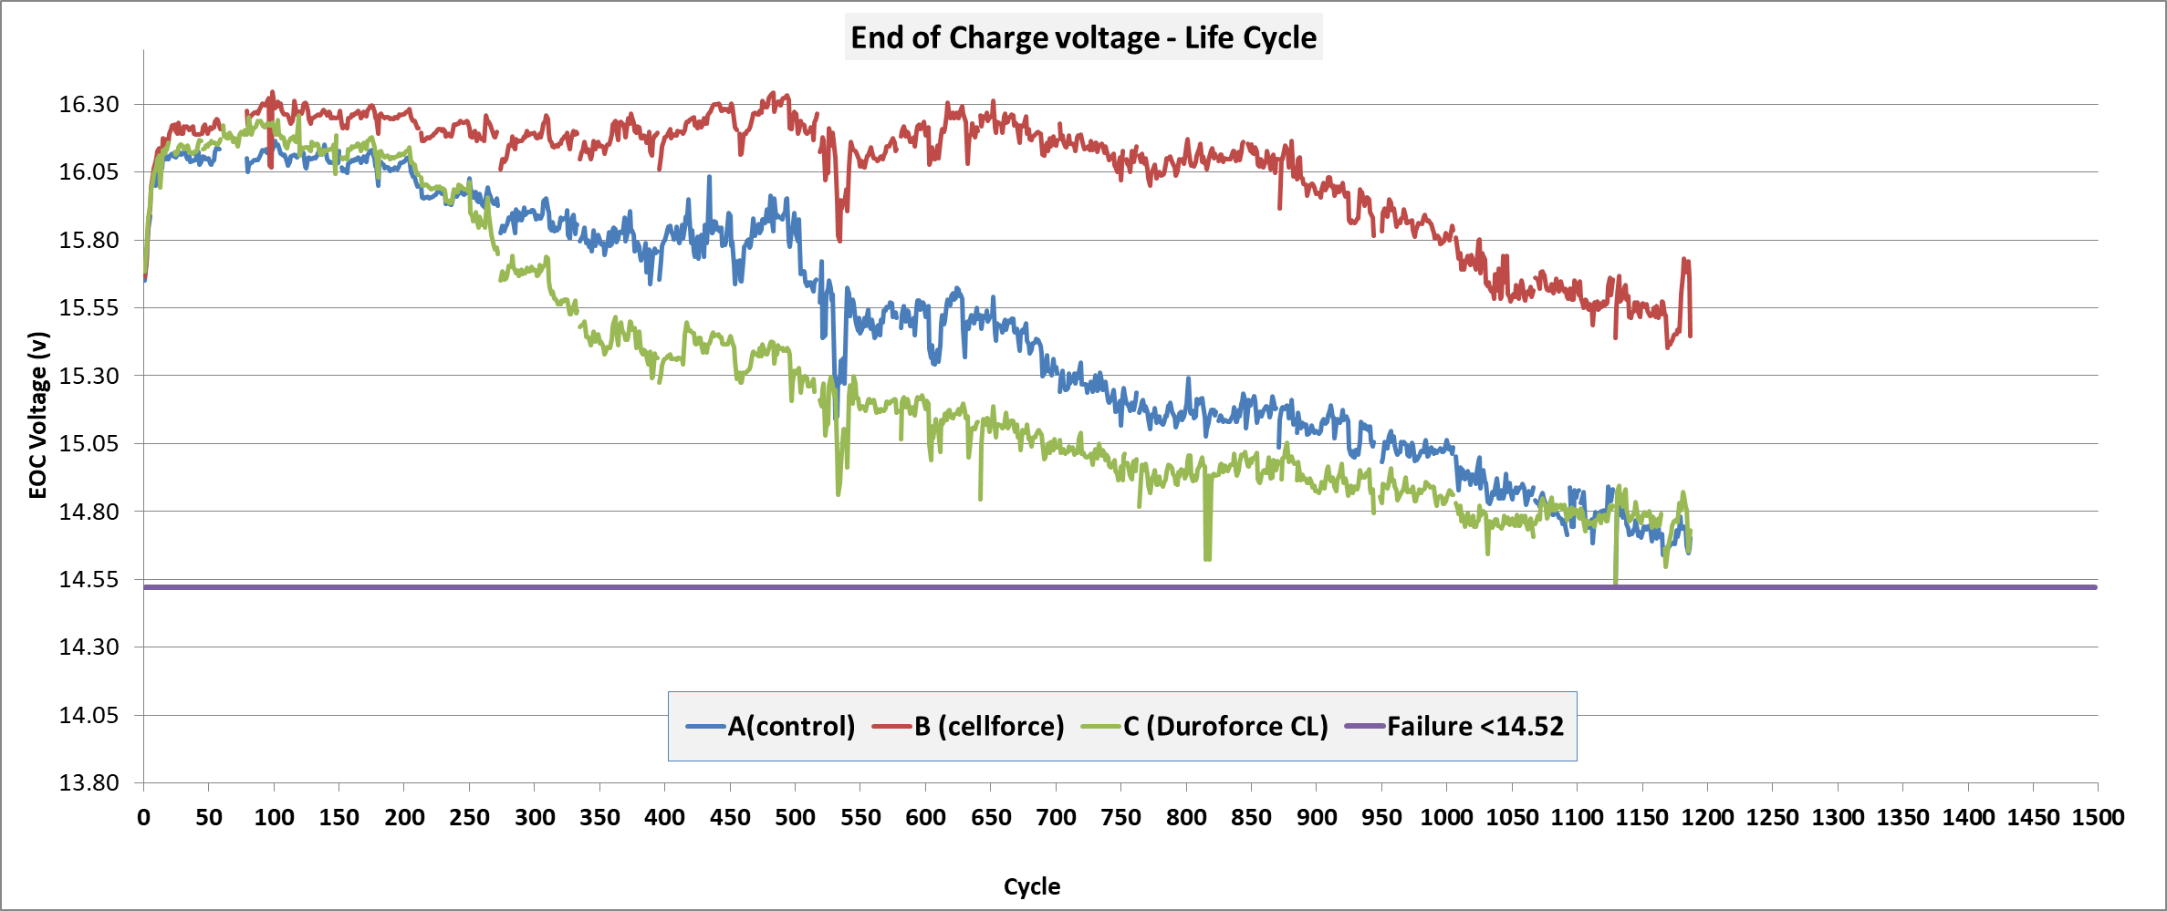
The 4th Active Material
Antimony Suppression
- Traction Battery -
- BATTERY TEST COMPARISON -
Notes:
Here is some recent data from our lab being generated for a traction battery comparison test. CellForce vs two different types of polyethylene.

Slide 29
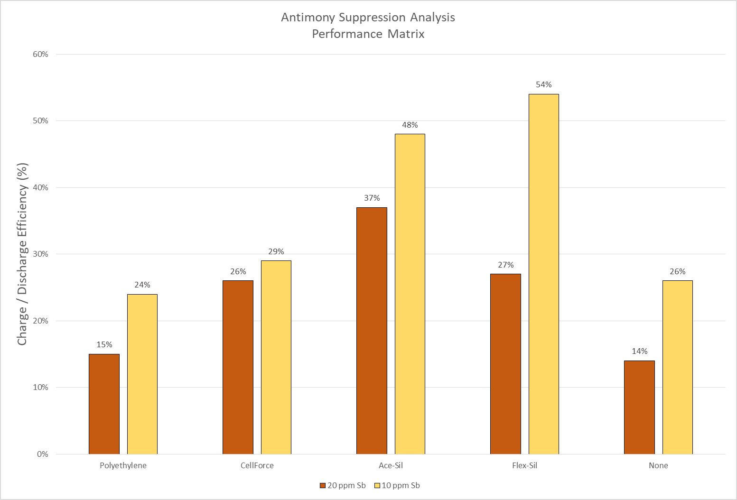
The 4th Active Material
Antimony Suppression Analysis
Separator Types – Leachate Test
Notes:
Our FlexSil separator has a very positive response

