Slide 1
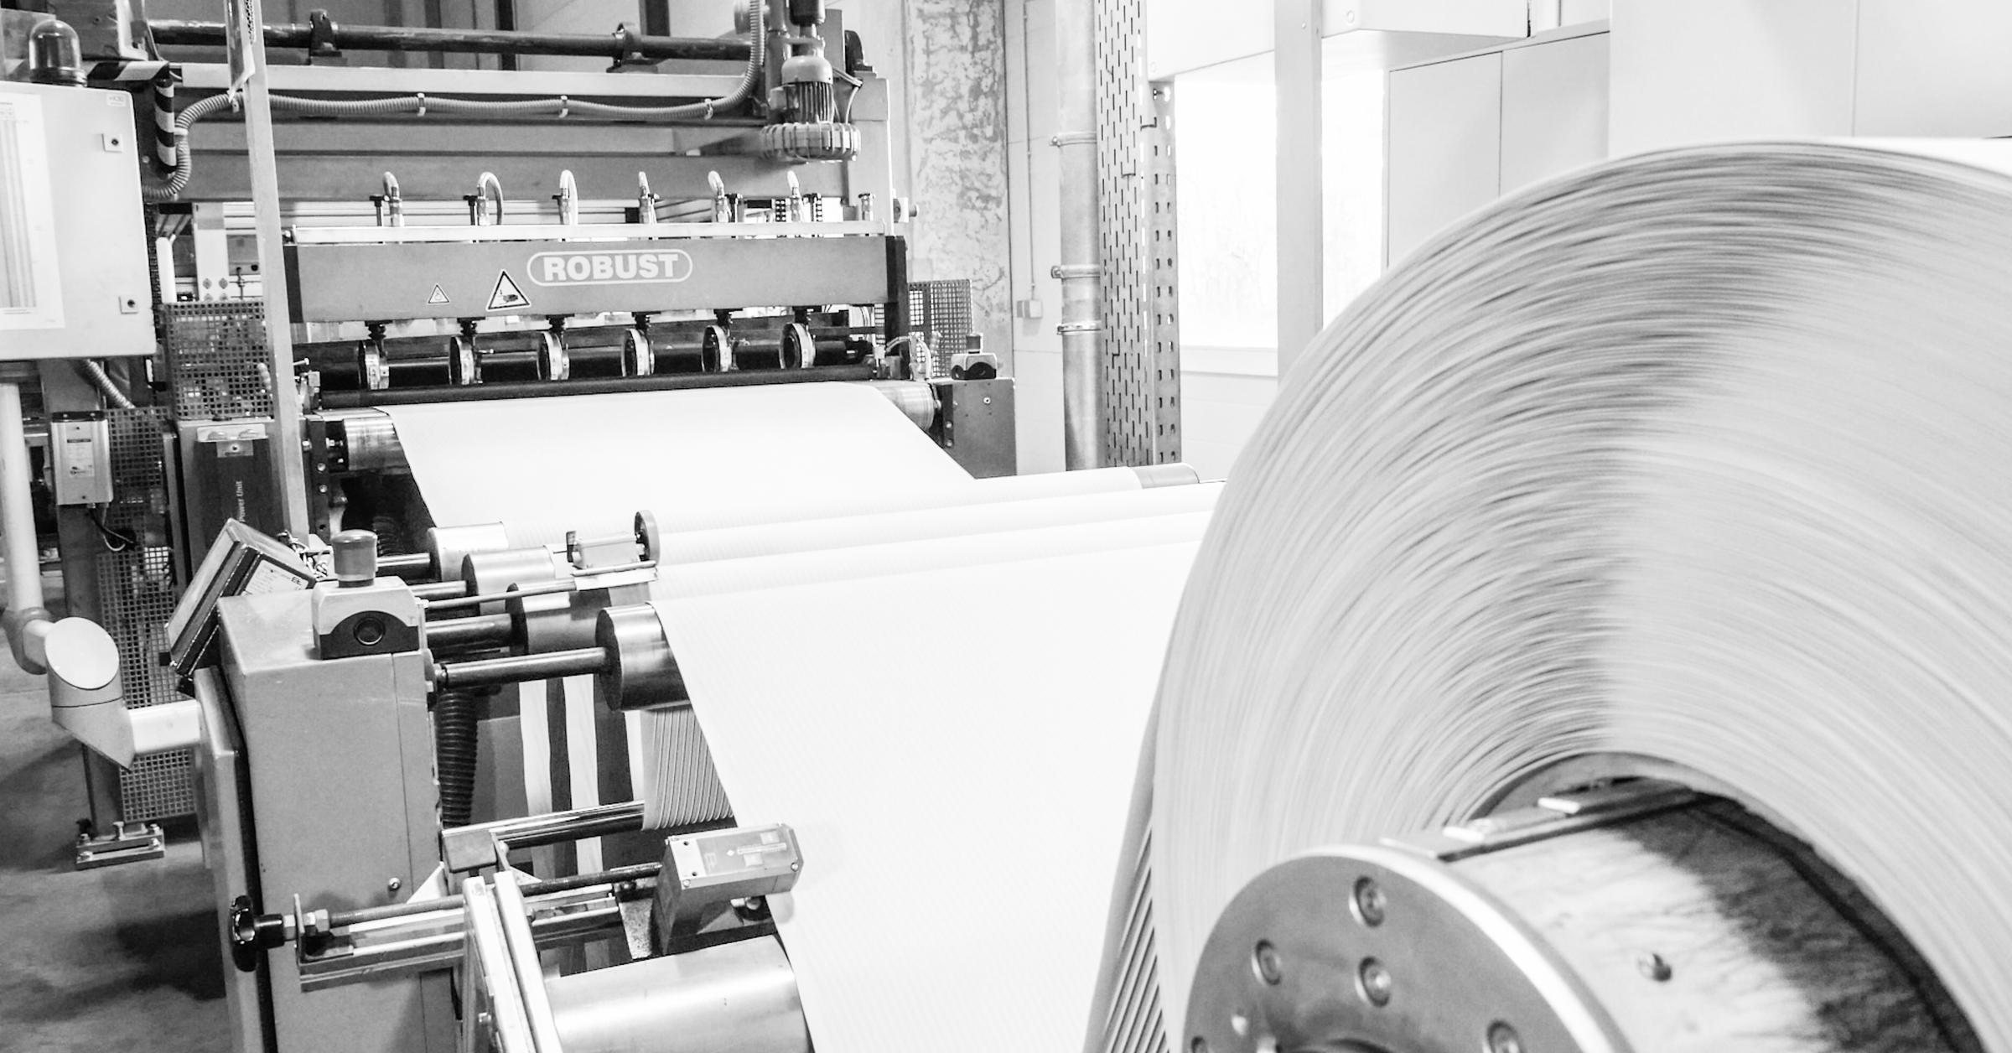
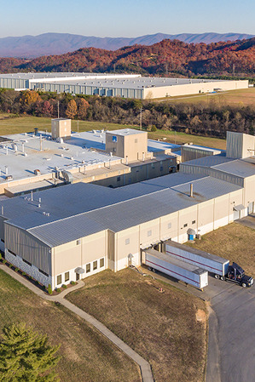

A Modular Approach
For Optimizing Battery Separators For High Charge Acceptance and Other Desired Attributes
DAVID MIHARA
VICE PRESIDENT OF TECHNOLOGY
MICROPOROUS LLC

Slide 2
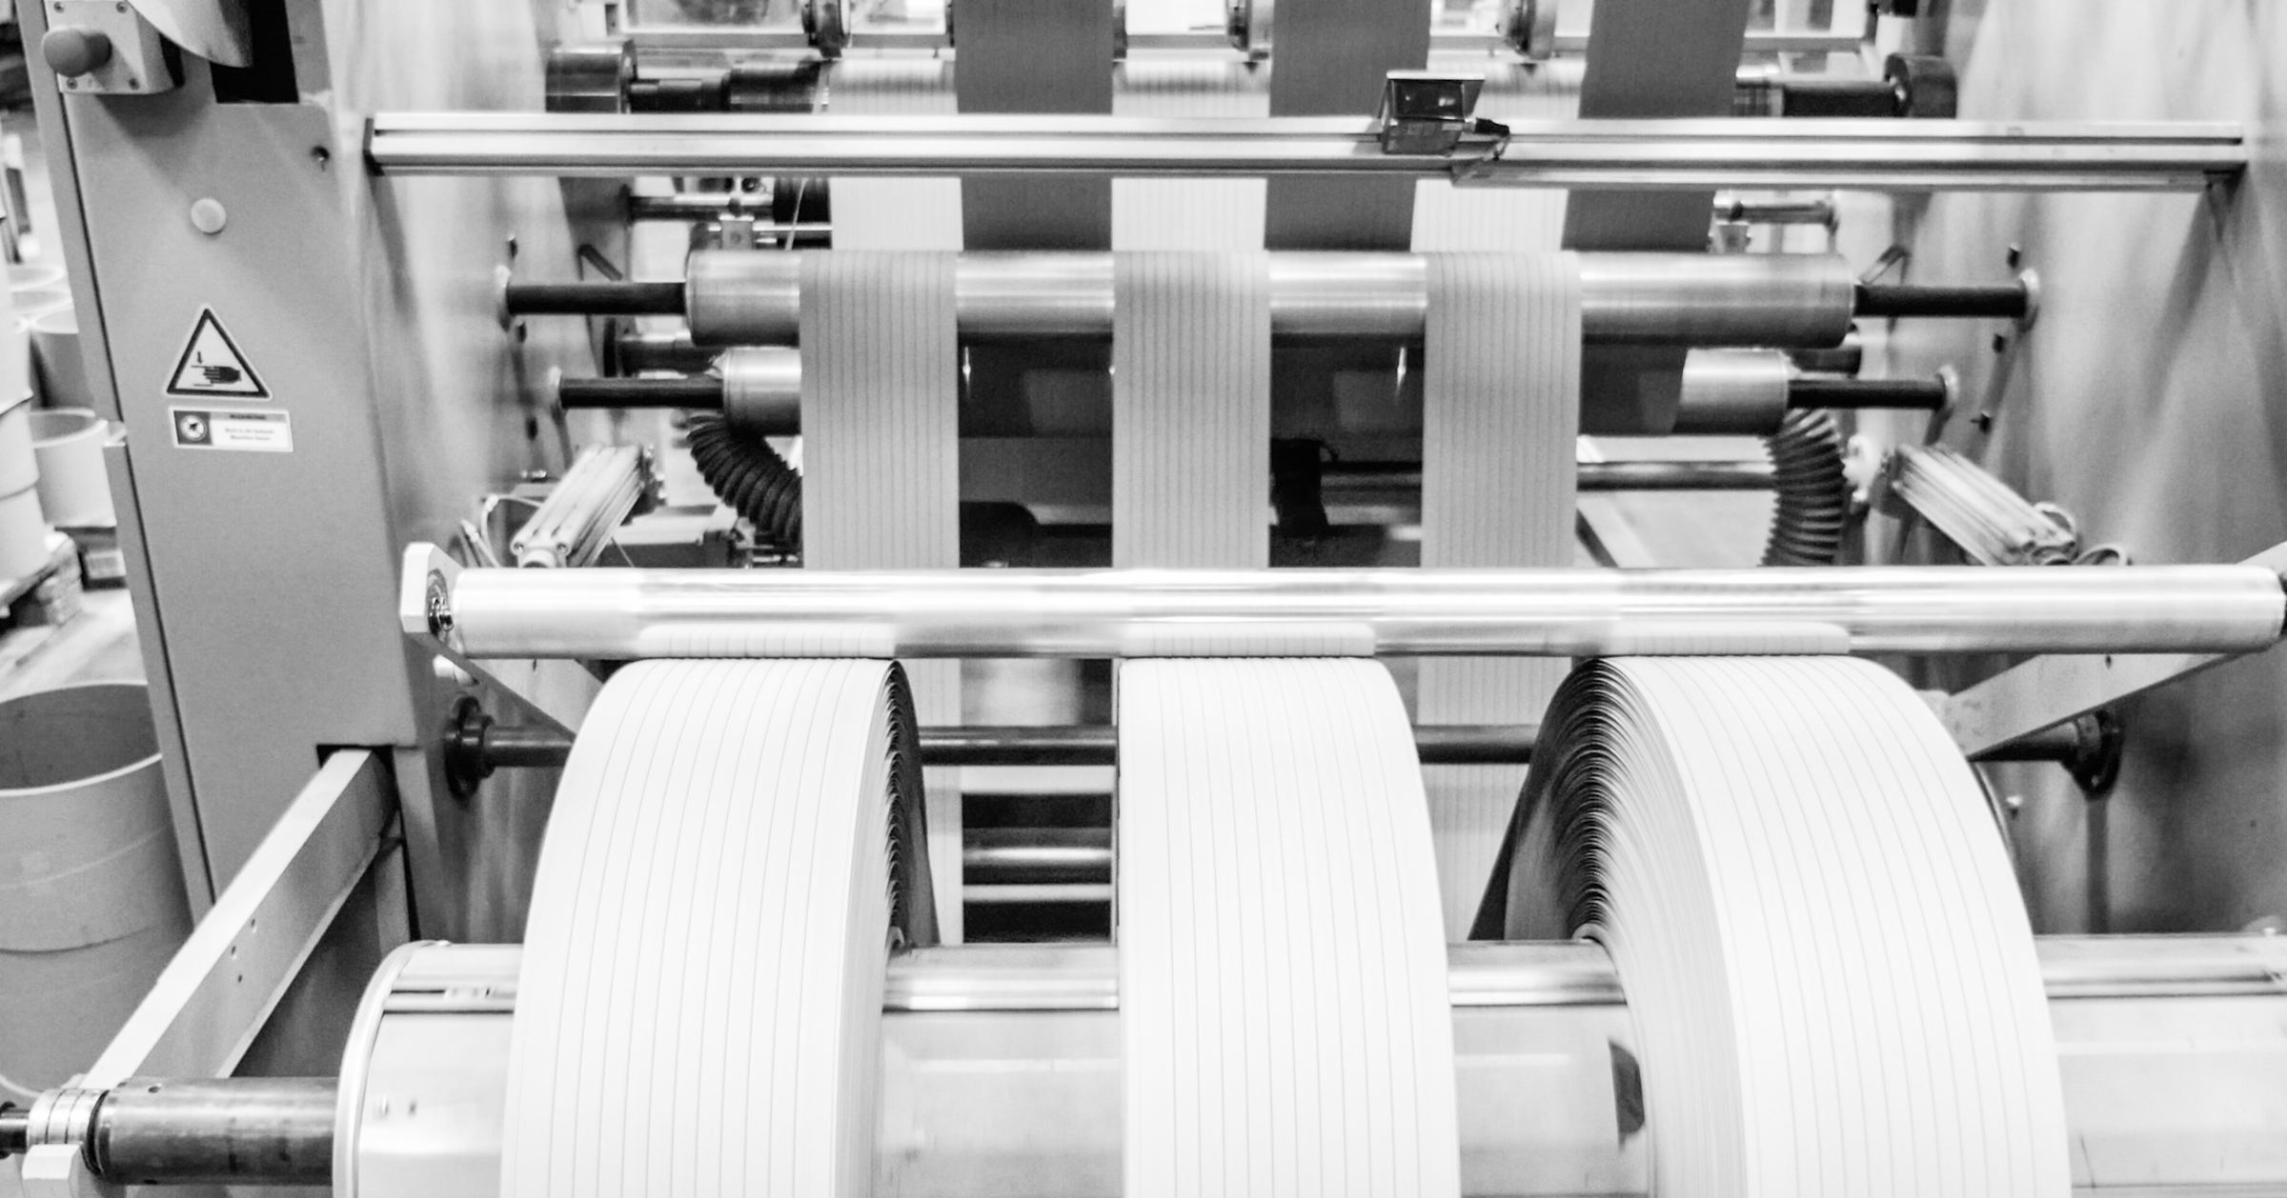
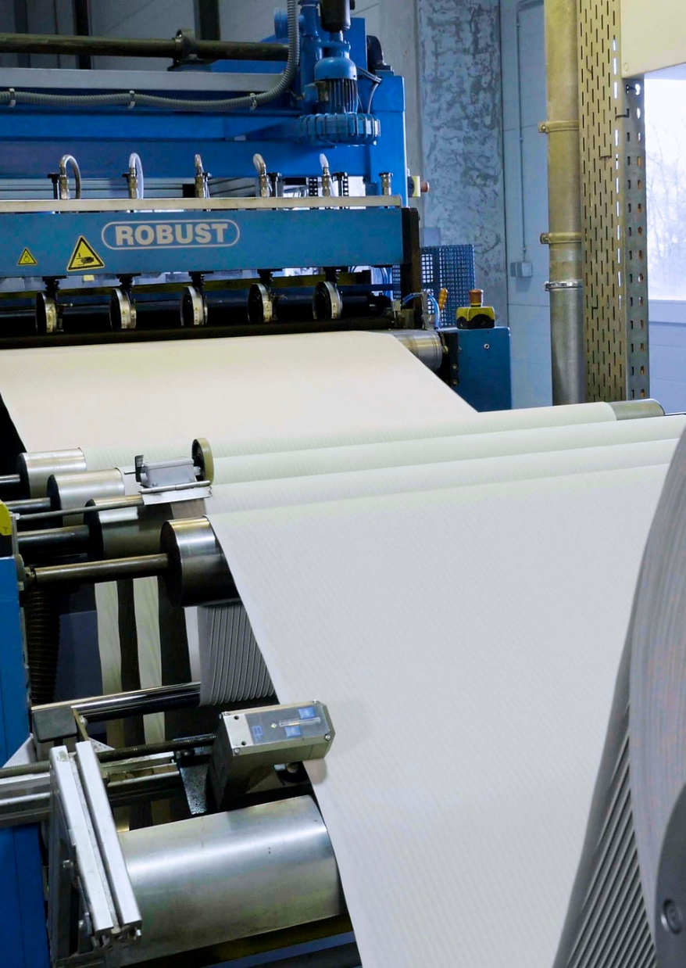

Today’s
Presentation
Introduction
Low Resistance Separator Properties
Low Resistance Separator Design
CellForce ULR
Modular Approach
Conclusion

Slide 3
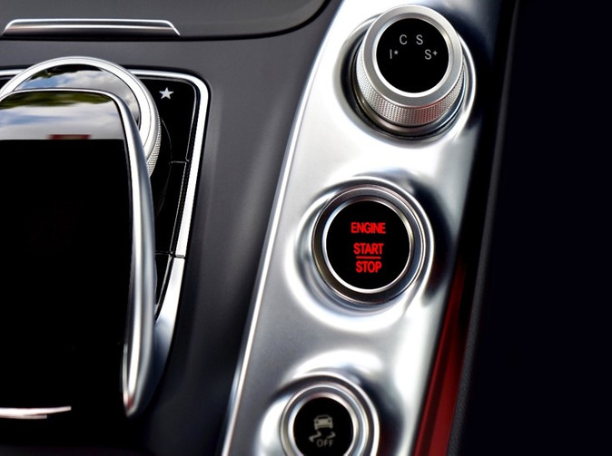
Introduction
The number of vehicles with micro hybrid, or Start Stop technology is increasing
This highlights the need for battery manufacturers to improve charge acceptance to avoid undercharging of batteries
Measures taken by manufacturers to improve charge acceptance efficiency, for instance use of high surface area carbons can in themselves lead to other issues which need to be controlled, e.g. water consumption

Slide 4
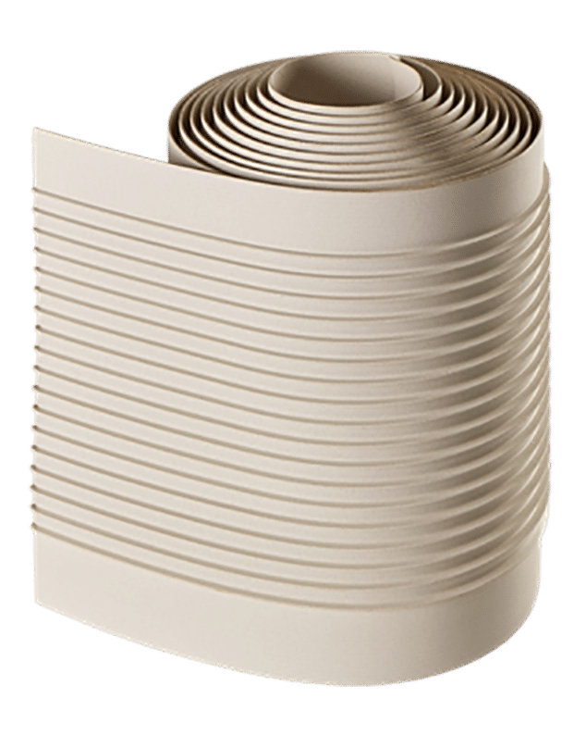
Introduction
Whilst the duty cycle of micro hybrid vehicles clearly has highlighted the need for optimizing charge acceptance, other applications could also benefit from improvements in efficiency
An example of this would be in motive power where deleterious effects of opportunity charging could be minimized with better charge acceptance
Can a battery separator help?
Yes, the obvious way is to minimize electrical resistance

Slide 5
Low Resistance
Separator Properties
PUNCTURE
OXIDATION
MD TENSILE
AND ELONGATION
POROSITY
CD TENSILE
AND ELONGATION
ELECTRICAL
RESISTANCE

Slide 6
SILICA TYPE
Low
Resistance
Separator
Design
SILICA TO
POLYMER RATIO
OIL CONTENT
CALENDAR ROLL
TEMPERATURE
POLYMER TYPE

Slide 7

CellForce ULR
Optimized materials and process
ER
Oxidation resistance maximized
Rubber/PE hybrid separator
(rubber content helps with oxidation
resistance and antimony suppression)

Slide 8
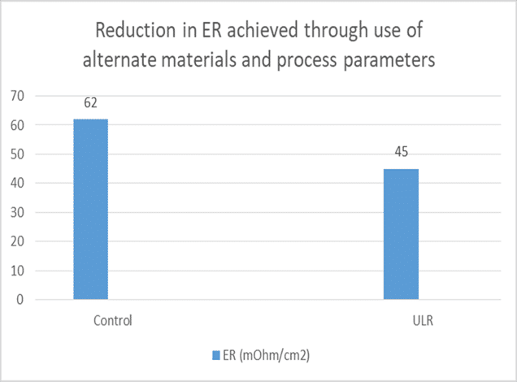
CellForce ULR
40%
OF A REDUCTION IN ER
Trials run over the past 6 months have consistently
Demonstrated a reduction in ER of 40%

Slide 9
MODULAR APPROACH
High charge acceptance in batteries is proving to be a key not only for EFB, but in other areas including Motive Power where opportunity charging has become a key
Whether it be in automotive or other areas, more demanding battery applications are revealing other requirements where we feel separators can contribute
Other customers want which are emerging include:
Water consumption control
Stratification reduction
High efficiency rib configurations
Use of carbons for high charge acceptance
R&D strategy is being developed to offer a range of products which can be mixed and matched to suit customer needs

Slide 10
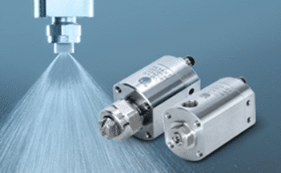
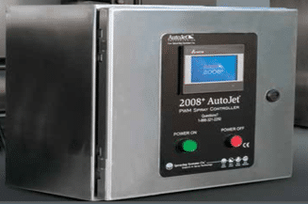
As mentioned earlier, use of carbons in NAM for charge acceptance improvement can increase water consumption significantly
We have been working with application of water consumption inhibition agents to standard and ULR separator
Through use of carefully controlled spray applicators, precise amounts of these agents are applied to the separator
Separators have been tested using the VW water consumption protocol as per the VDA
Water
Consumption
Control

Slide 11
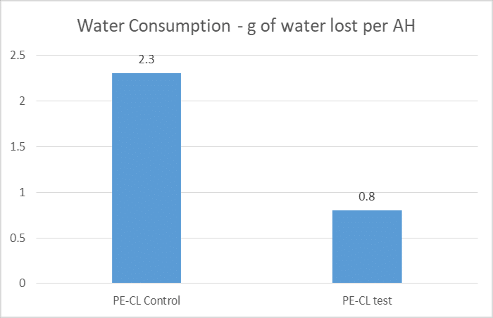
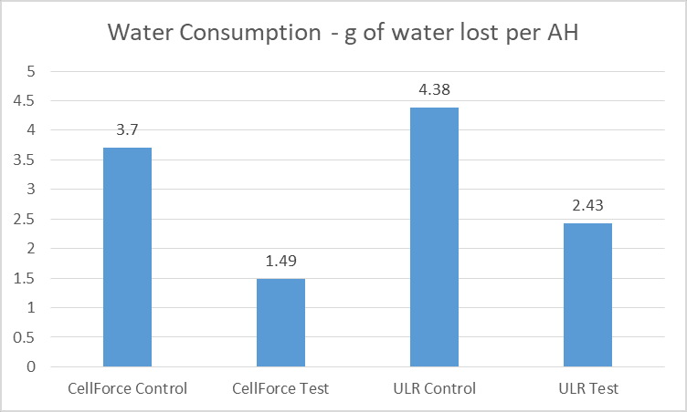
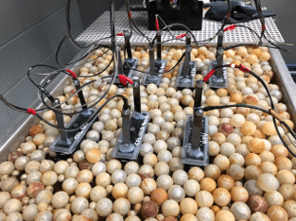
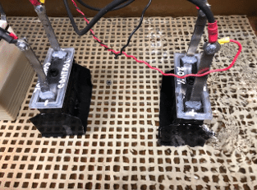
Water Consumption Control
Results have been encouraging and replicated
External Independent Lab
Microporous Piney Flats Lab

Slide 12
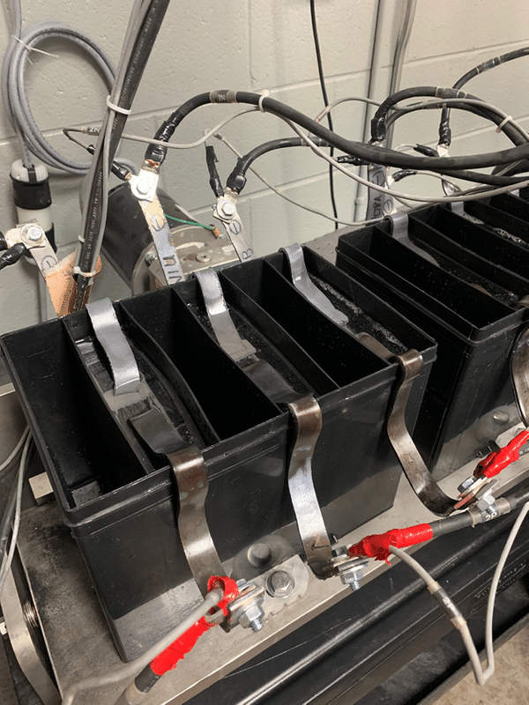
Stratification
Reduction
Acid Stratification Testing
9 Plate SLI Cells (PbCa)
C20 Capacity=40 Ah
EN 50342-6 Endurance Test
Discharge to 50% SoC at 8A
Charge 40 min at 14A
Discharge 30 min at 14A
Repeat steps 2-3 (20 times)

Slide 13
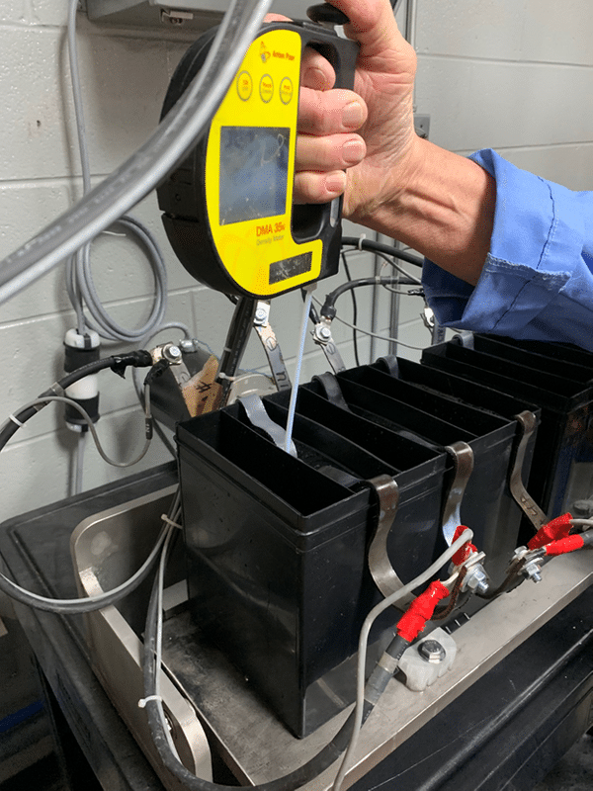
Stratification
Reduction
Acid Stratification Testing
Static Endurance Testing
Measure SG top and bottom of cells immediately after testing
Rocking Endurance Testing
Simulates Vehicle Motion
Rocking at +/-13 degrees-3 cycles per min
Measure SG top and bottom of cells immediately after testing

Slide 14
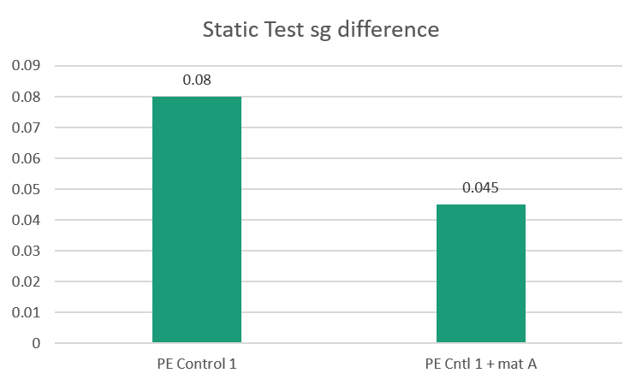
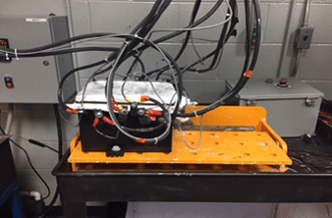
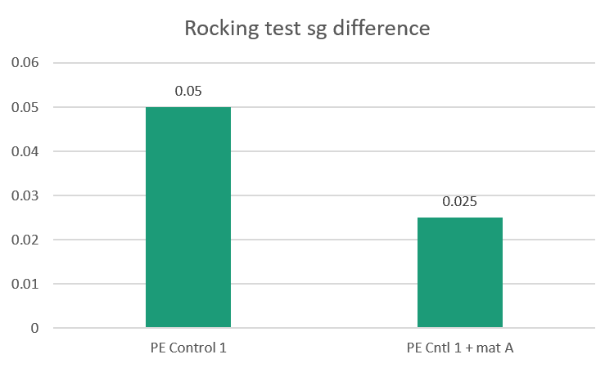
Stratification
Reduction
Many variants of different rib configurations and glass mats have been tried
Most improvement seen with glass mat variants

Slide 15
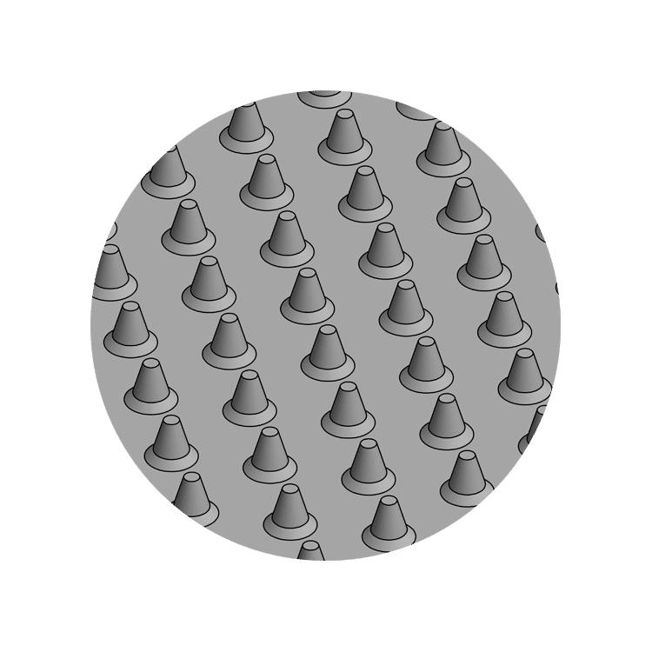
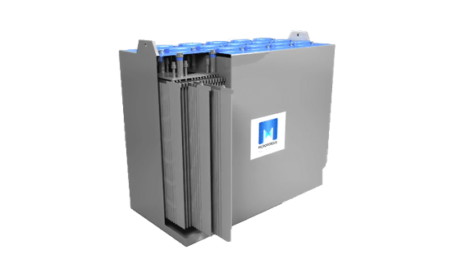
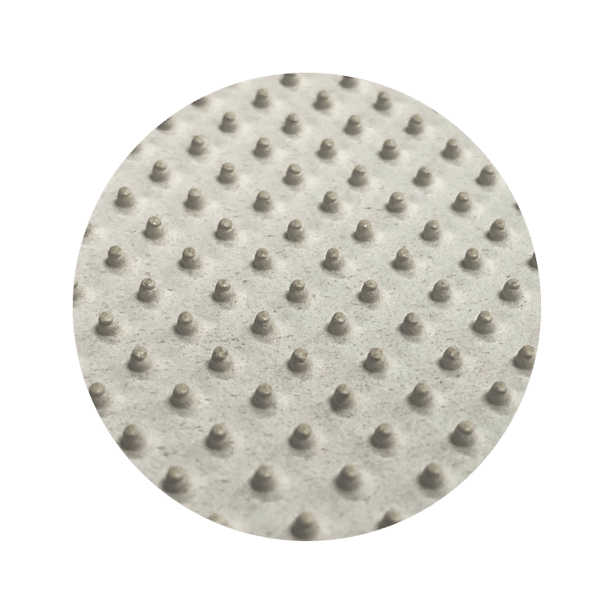
hE Profile Where Less Is More
Microporous’ new hE profile improves Acid Displacement by up to 25% while also improving Electrical Resistance by 20%.
hE offers a compelling solution for traction and other deep cycle batteries.
hE Profile ADVANTAGES:
Higher capacity
Improved charge acceptance
Extended cycle life
Reduces risk of separator corrosion and shorts
Reduces risk of shorts
APPLICATIONS:
High
Efficiency
Profile
Forklift
Renewable Energy
Aerial Platform
Solar Power
Mining
Locomotive
Low Speed EV

Slide 16
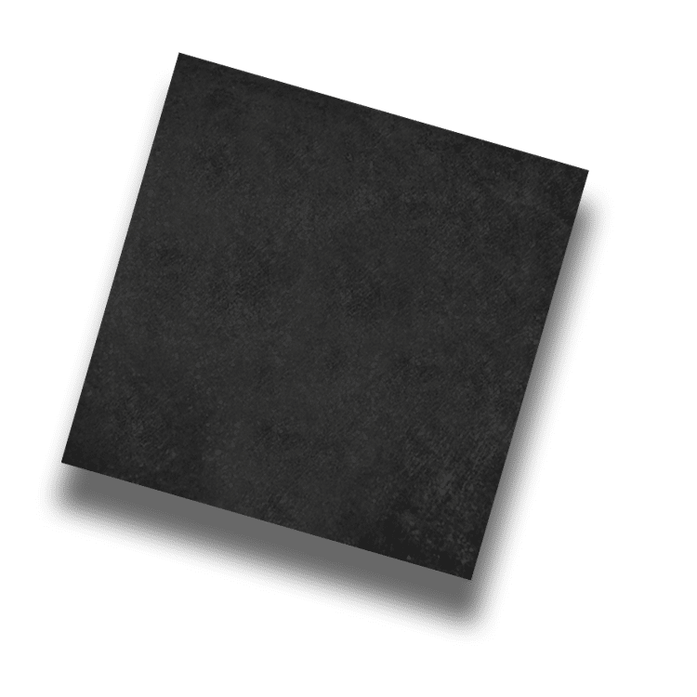
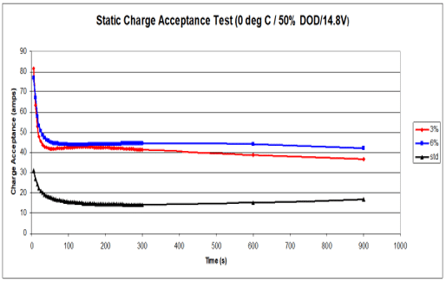
DCA
Booster
Mat
Using the separator as a delivery vehicle for carbon
The use of carbon to increase charge acceptance is not a new concept. Its applicability for practical use in lead acid batteries has however lagged behind.
This is changing, especially with the advent of EFB in automotive and the realization that opportunity charging in traction can be significantly helped
It is not a big leap to also assume that UPA and telecom (unstable grid) could significantly benefit

Slide 17
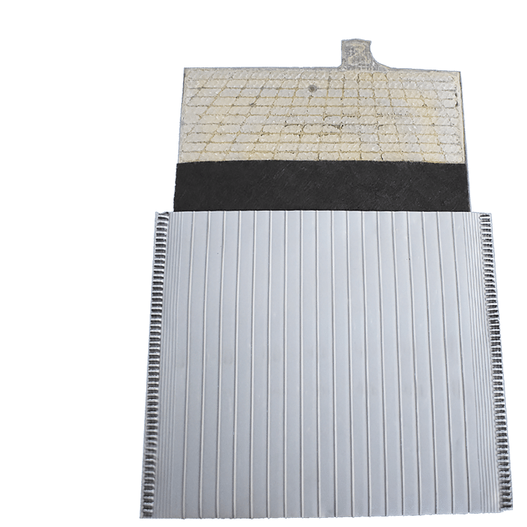
DCA
Booster
Mat
Using the separator as a delivery vehicle for carbon
The use of carbon to increase charge acceptance is not a new concept. Its applicability for practical use in lead acid batteries has however lagged behind.
This is changing, especially with the advent of EFB in automotive and the realization that opportunity charging in traction can be significantly helped
It is not a big leap to also assume that UPA and telecom (unstable grid) could significantly benefit

Slide 18
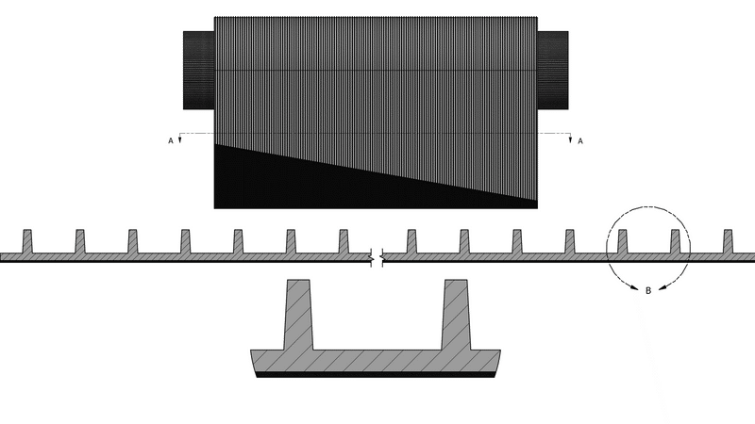
DCA
Booster
Mat
Separator
Booster
Mat

Slide 19
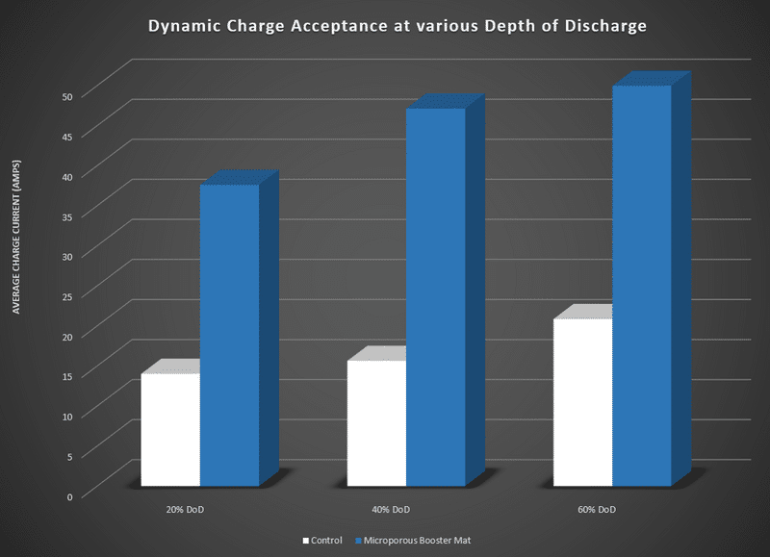

DCA
Booster
Mat

Slide 20

Ultra Low Resistance
Separator
Water Consumption
Control
CONCLUSION
Stratification
Reduction
High Efficiency
Rib Configuration
Use of Carbons

Slide 21

THANK
YOU

